Slide 1
LMRFC Reference Slide For Crest Tables
LMRFC Forecasts Issued Morning of May 25, 2022
Lower Mississippi
RIVER FORECAST CENTER
Talking Points
New Orleans, LA on the lower Mississippi River is cresting now and slow falls are expected over the next several days.
Minor rises are occurring on the lower Ohio River and crests should occur over the next couple of days. Crest levels will be well below flood levels.
As rises from lower Ohio River move downstream on the lower Mississippi River, the rises will slowly dampen as they approach the confluence with the Arkansas River.
Minor flooding continues at Red River Landing, LA and it is forecast to fall below flood stage this weekend.
The 16 day future rainfall guidance shows slightly higher levels from the official forecast on the lower Ohio and lower Mississippi Rivers. After this weekend, the guidance is showing no locations being in flood for the lower Mississippi River.

Slide 2
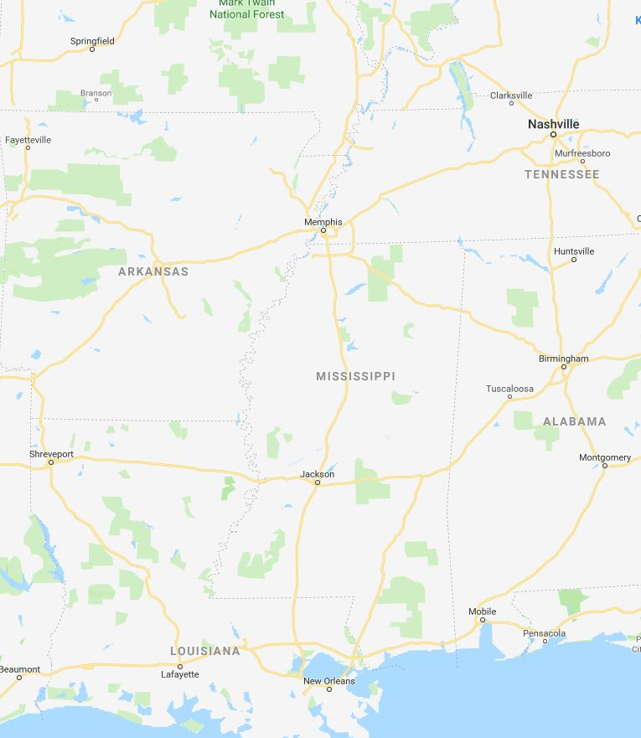
Ohio/Mississippi River Crest Watch
Created May 25 2022 @ 11:00 am CDT
Lower Mississippi River Forecast Center weather.gov/lmrfc
NWSLMRFC
@NWSLMRFC
MS River at Caruthersville
OH River at Paducah
Current: 20.8’
2 Days
Current: 18.4’
Forecast:
Rises over the several days
Forecast:
Rises over the next 5 days
MS River at Memphis
2 Days
0.5 Day
OH River at Cairo
Current: 14.8’
Current: 29.8’
Forecast:
Rises over the next 5 days
Forecast:
Rises over the next few days
MS River at Ark City
5 Days
MS River at Greenville
Current: 26.7’
Current: 38.4’
Slow rises over the next 5 days
ACTION
Forecast:
Forecast:
Slow rises over the next 5 days
2 Days
1 Day
MS River at Natchez
MS River at Vicksburg
Current: 46.9’
ACTION
ACTION
Falls over the next several days and remaining in ACTION over the next 5 days
Current: 38.1’
Forecast:
Forecast:
Falls for a couple of days and remaining in ACTION over the next 5 days
2 Days
MS River at Baton Rouge
2 Days
MS River at New Orleans
Current: 32.7’
Current: 12.2’
ACTION
Forecast:
Slow falls over the next 5 days
Forecast:
Falls and remaining above
ACTION over the next 5 days
Bonnet Carré Location
Crest Location

